Slide 1
“If you want to get laid, go to college...”
Dave Pattern
Library Systems Manager
University of Huddersfield, UK
d.c.pattern@hud.ac.uk
www.daveyp.com/blog/

Slide 2
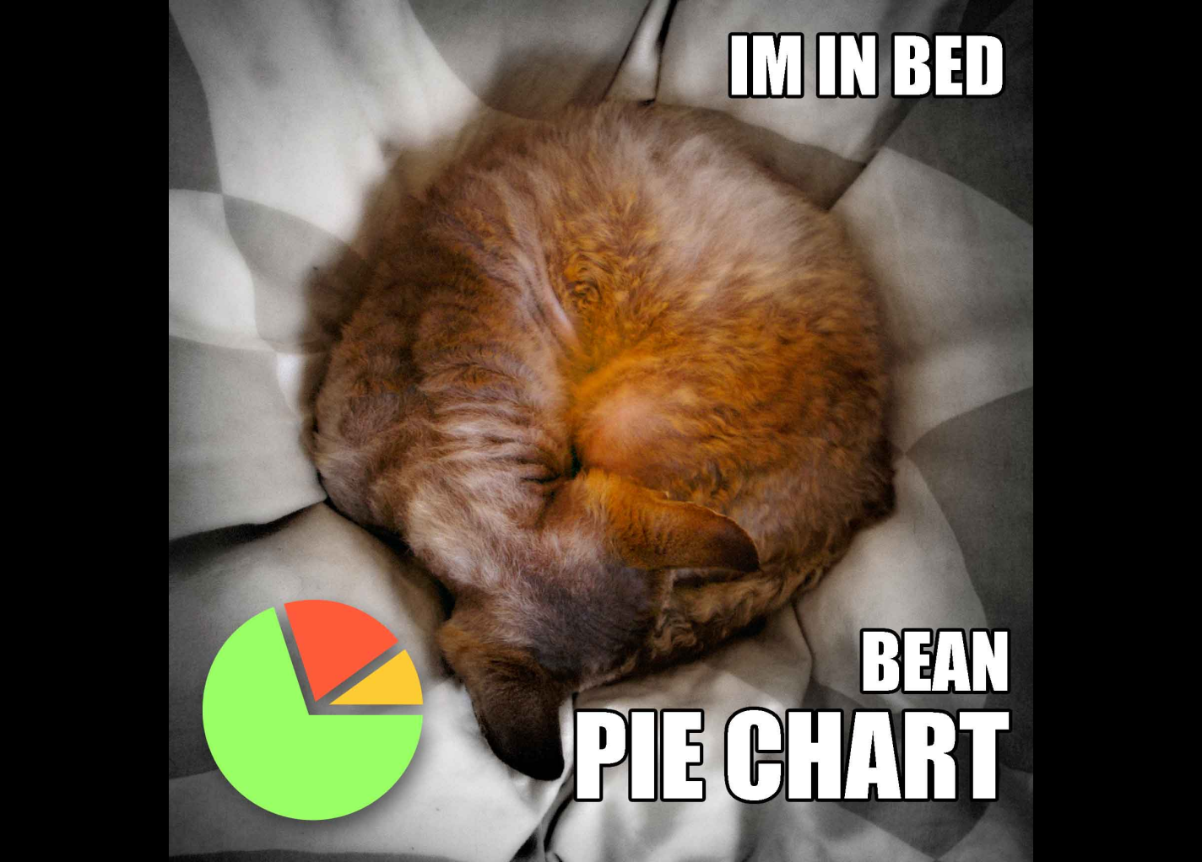
Warning!
this presentation contains charts

Slide 3
Preamble
Presentation available at:
  daveyp.com/blog/
Please remix and reuse this presentation
  creativecommons.org/licenses/by-nc-sa/3.0
Have you switched your phone on?
  please feel free to take photos, record audio, blog, tweet (@daveyp), etc! ☺

Slide 4
Hashtag!
#cilipw11

Slide 5

What am I going to talk about?
Notes:
http://www.flickr.com/photos/davepattern/5627724109/in/photostream/

Slide 6
Using Usage Data…
…to improve existing services
…to gain insights into user behaviour
…to measure the impact of the library
  do the students who use the library the most get the highest grades?

Slide 7
Defining Using Usage
JISC Activity Data Programme
User activity data
  record of a user’s actions on a website or software system or other relevant institutional service
Attention data
  record of what a user has viewed on a website or software system or other relevant institutional service
  http://bit.ly/g6S5wH

Slide 8
Defining Usage Data
some library examples...
Circulation Transactions
  user A borrowed this book on 23/Jan/2011
E-Resource Usage
  user B logged in and accessed ScienceDirect 126 times during 2009
Entry Stats
  user C entered the library 12 times in Dec/2009

Slide 9

Usage Data at Huddersfield

Slide 10
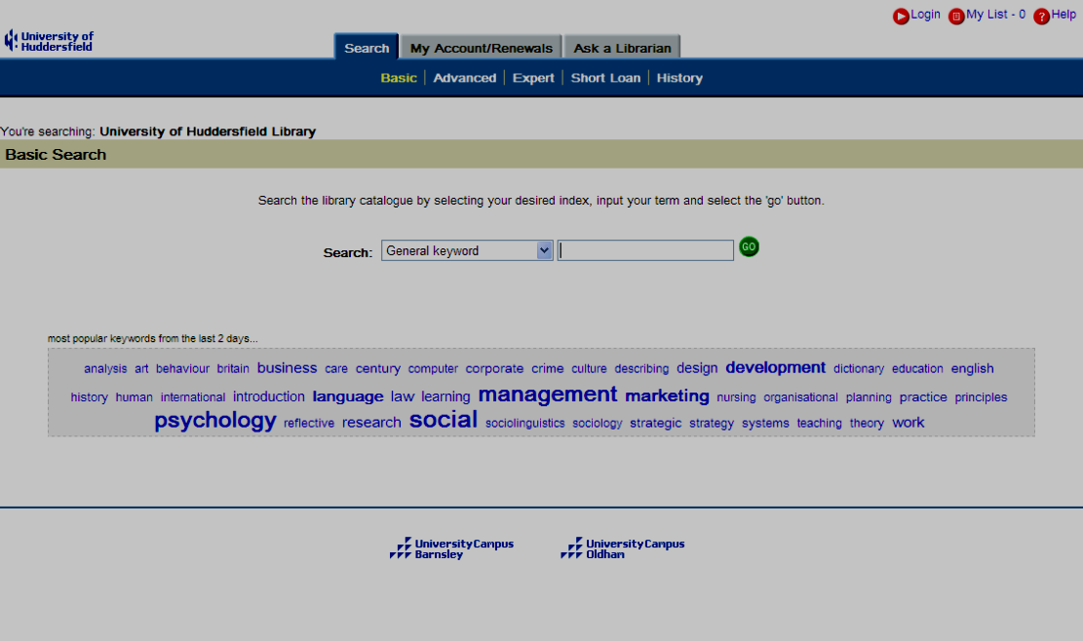
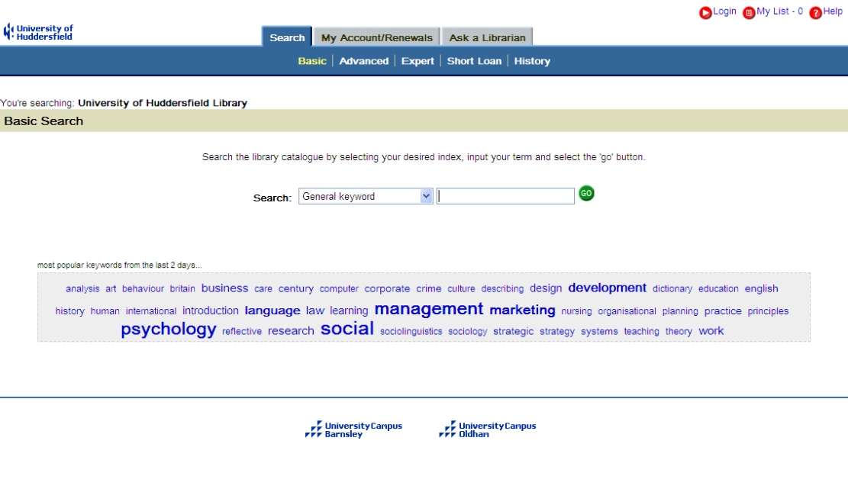
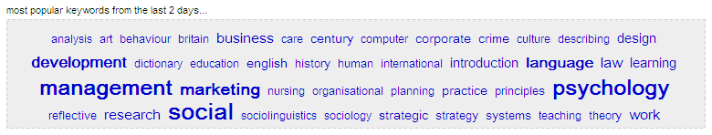
Keyword Cloud
based on keyword search data
10

Slide 11
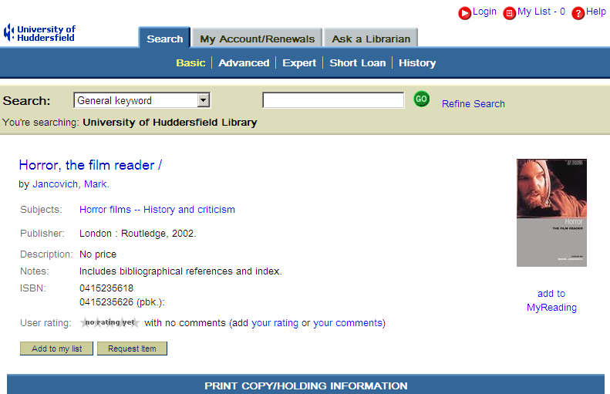

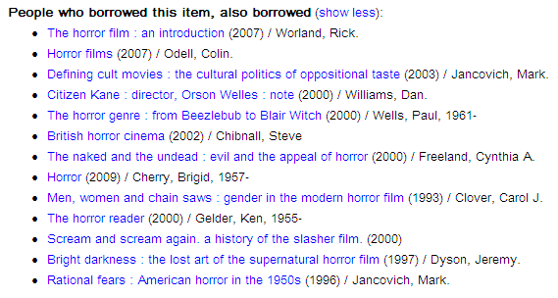
Borrowing Suggestions based on circulation data

Slide 12
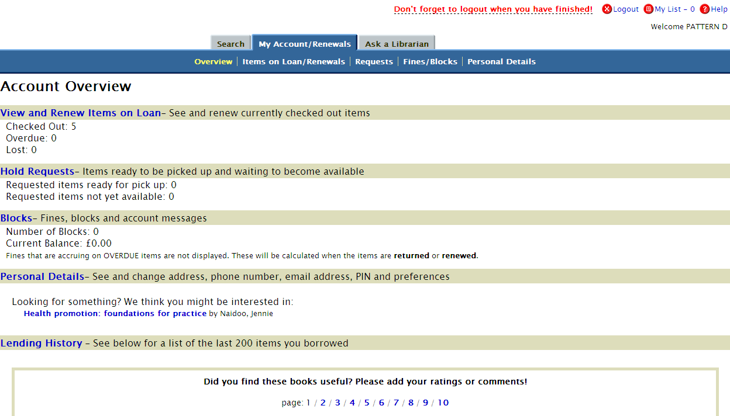
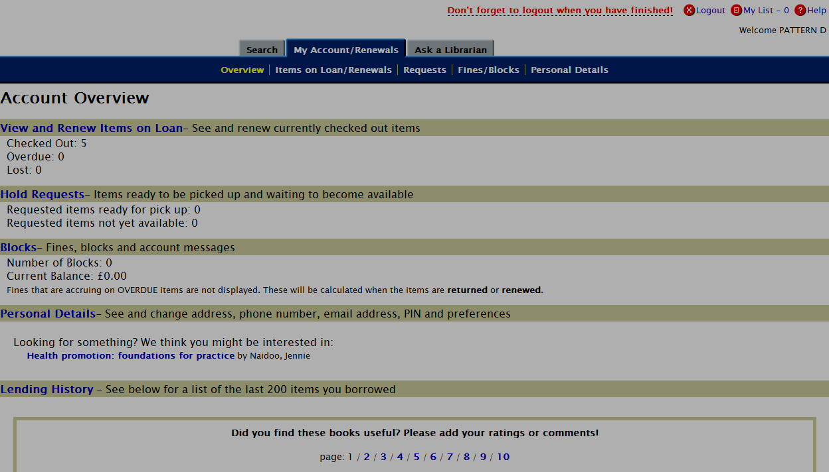

Borrowing Suggestions
based on user’s recent loans

Slide 13
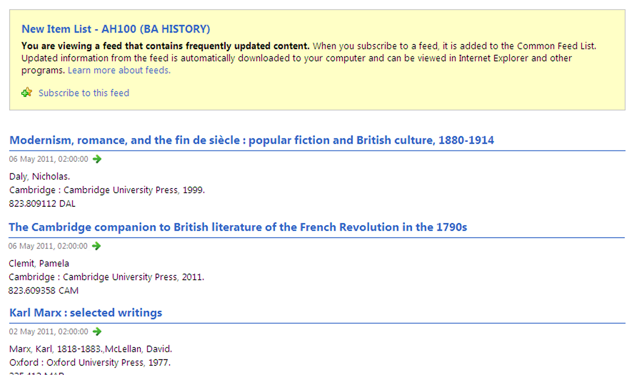
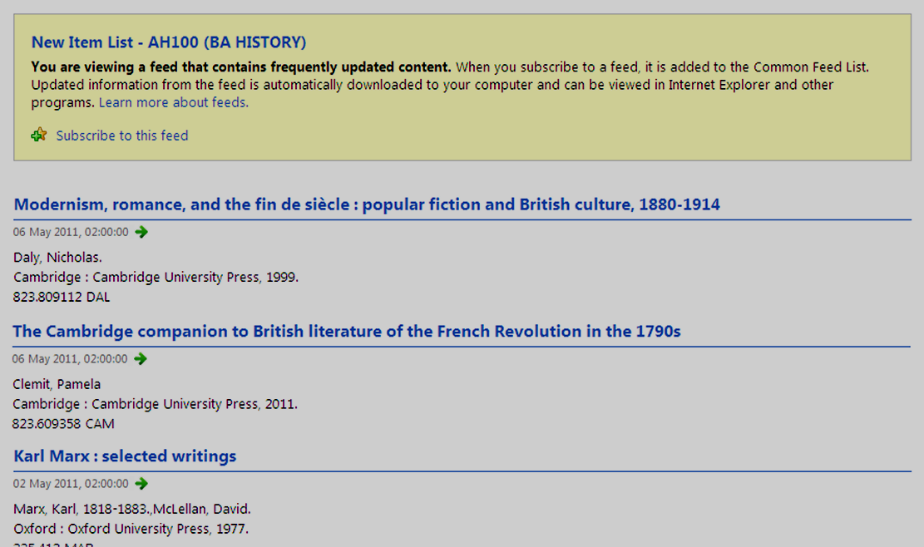
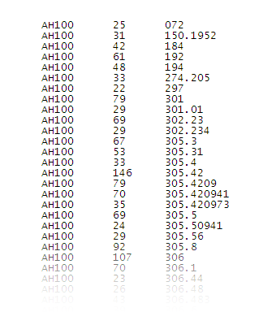
Course Level New Book Lists
analysis of course loans & Dewey

Slide 14
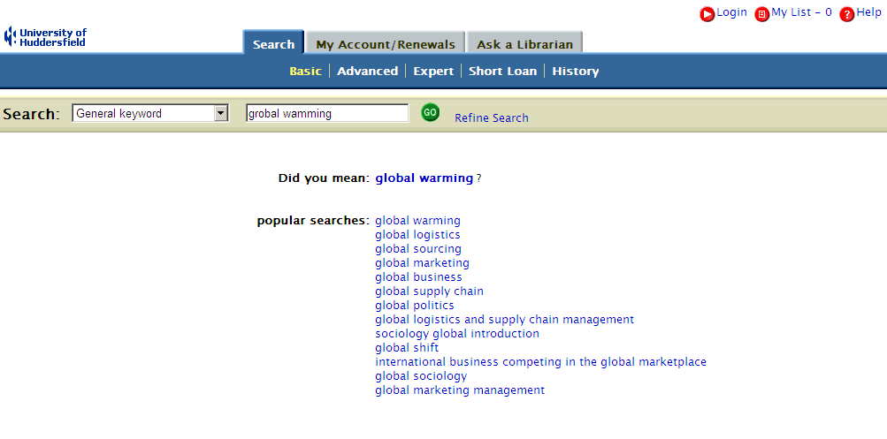
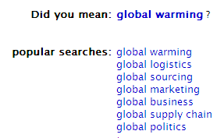
Search Suggestions
based on keyword search data
14

Slide 15
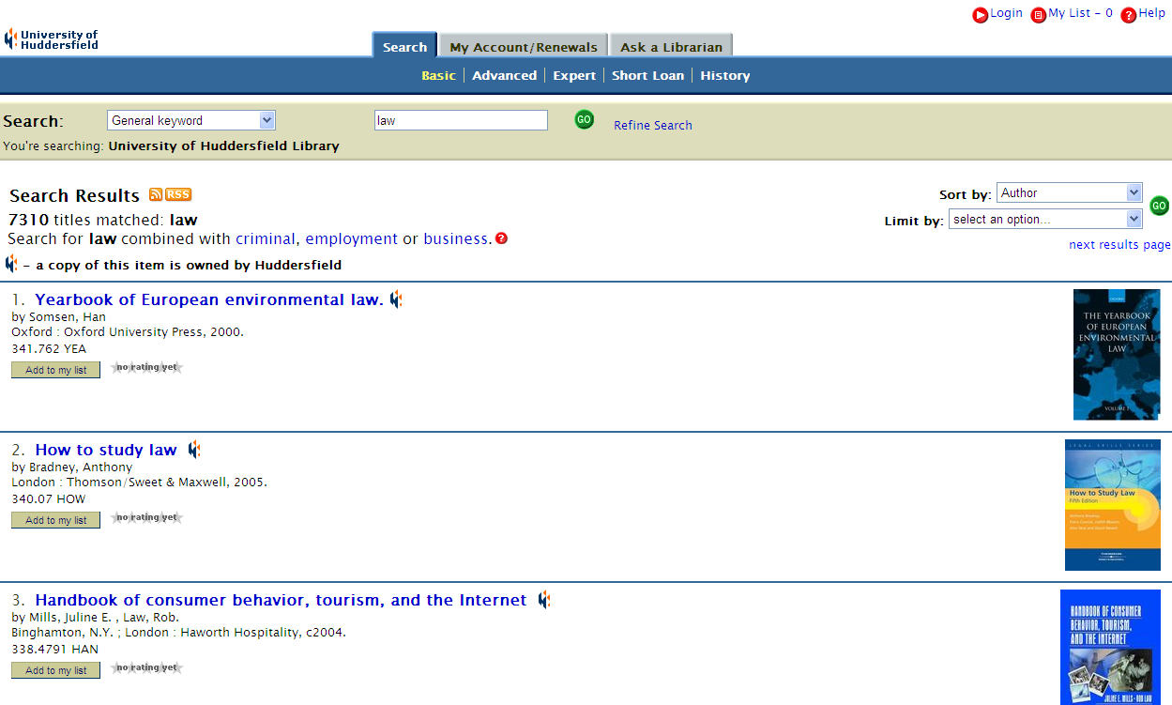
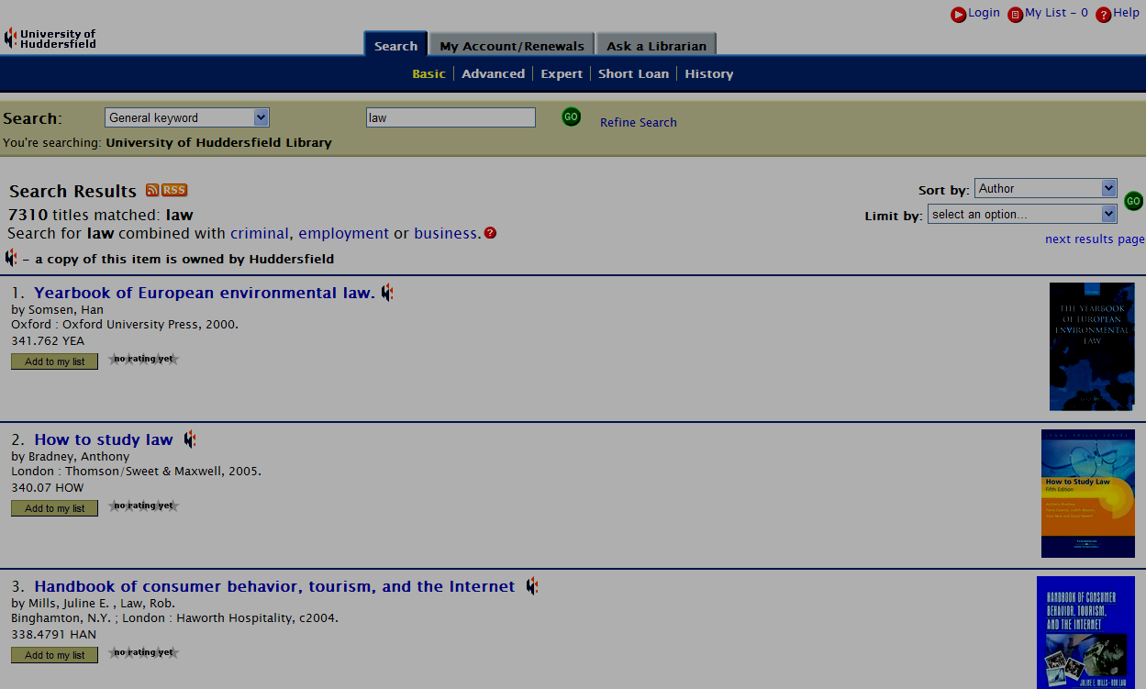
Guided Keyword Searches
based on keyword search data
15

Slide 16
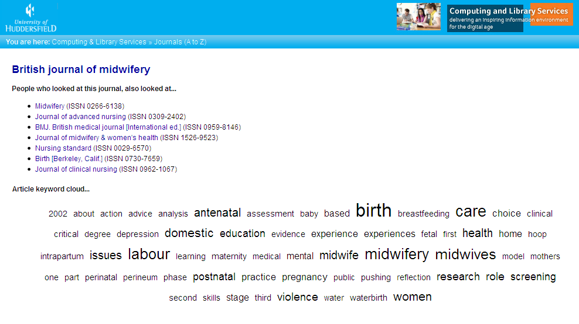
Journal Suggestions
based on link resolver logs
16

Slide 17
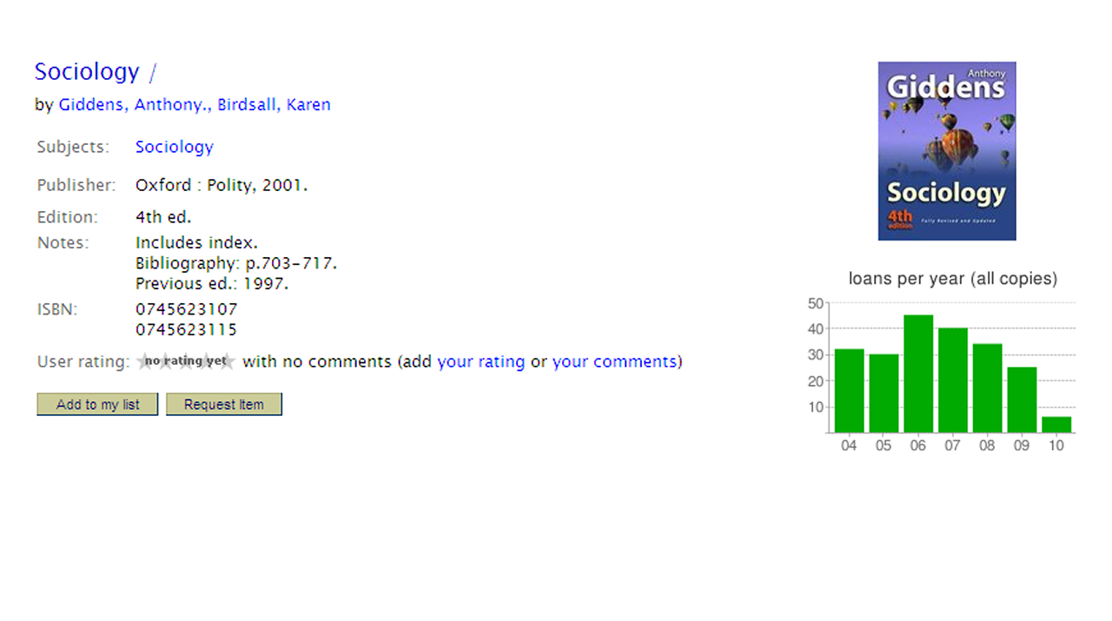
Borrowing Statistics
based on circulation data
17

Slide 18
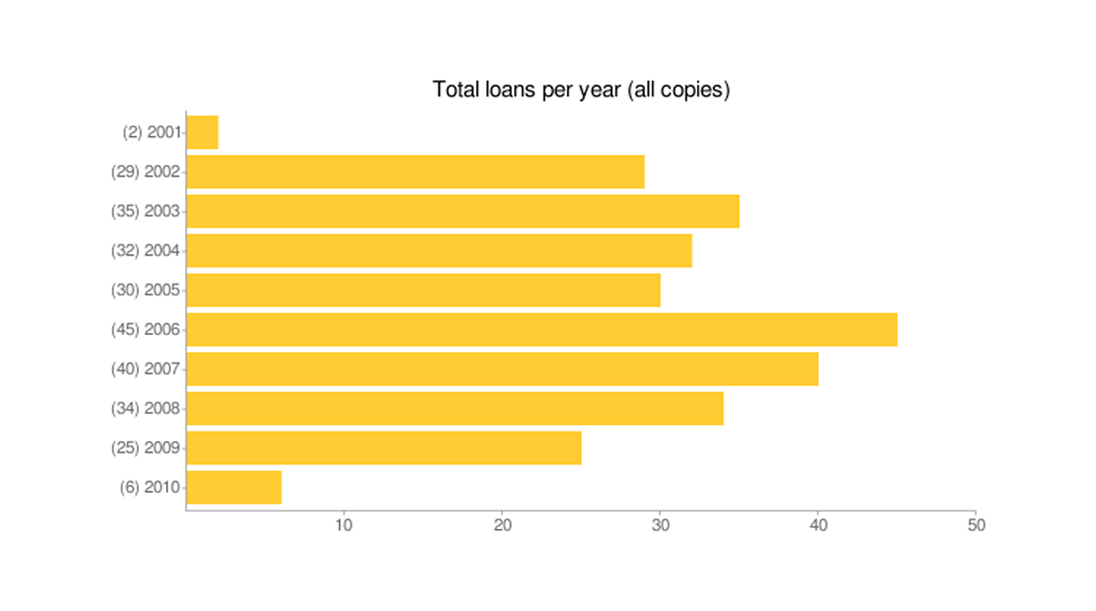
Borrowing Statistics
based on circulation data
18

Slide 19
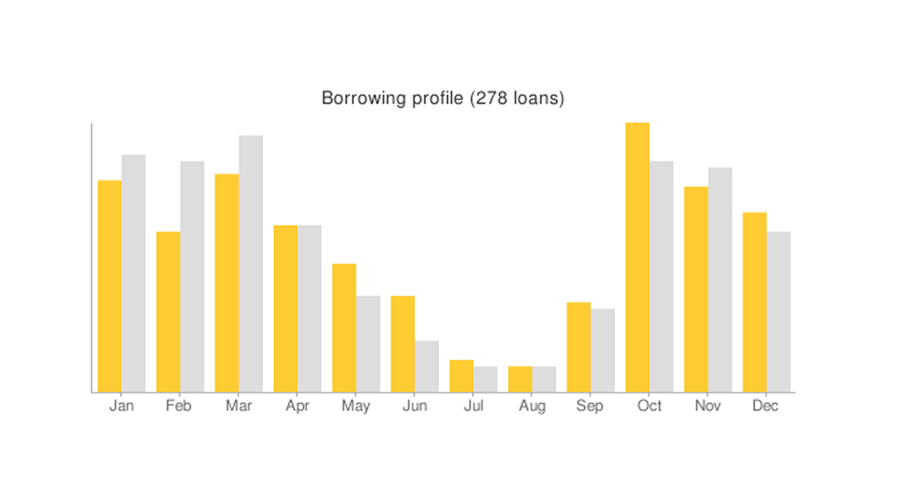
Borrowing Statistics
based on circulation data
19

Slide 20
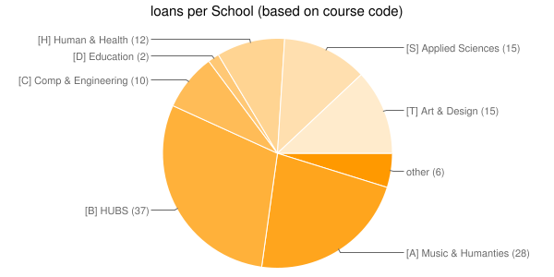
Borrowing Statistics
based on circulation data
20

Slide 21

The Impact of Serendipity

Slide 22
Trends in Borrowing
unique titles circ’ing per acad. year
22
Notes:
The total number of unique titles (i.e. not individual copies) circulating per academic year.
Since 2005, the range of stock being borrowed has increased year-on-year.

Slide 23
Trends in Borrowing
# of items borrowed per acad. year
17.10
18.92
23
Notes:
Average number of items borrowed per academic year by active borrowers.
Since 2005, the number has increased year-on-year.

Slide 24
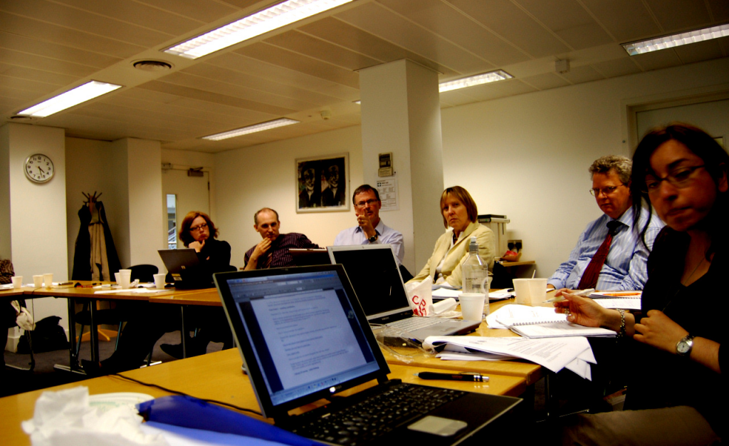
Discussing Open Data
JISC TILE Project meeting (Jun 2008)
24
Notes:
Tile Project meeting on 18th June 2008 at LSE, London
http://www.flickr.com/photos/davepattern/2590224337/

Slide 25
Sharing Data
Why should I release my data?
“The coolest thing to do with your data
will be thought of by someone else.”
  Rufus Pollack (Open Knowledge Foundation) http://m.okfn.org/files/talks/xtech_2007/

Slide 26
Sharing Data
Why should I release my data?
“Absolutely, couldn’t agree more.
The point is not so much whether this
statement might be true or not, so
much as what it does to your thinking
and planning if you decide to take it as
an article of faith.”
  Paul Walk (UKOLN) http://bit.ly/9ao3c4

Slide 27
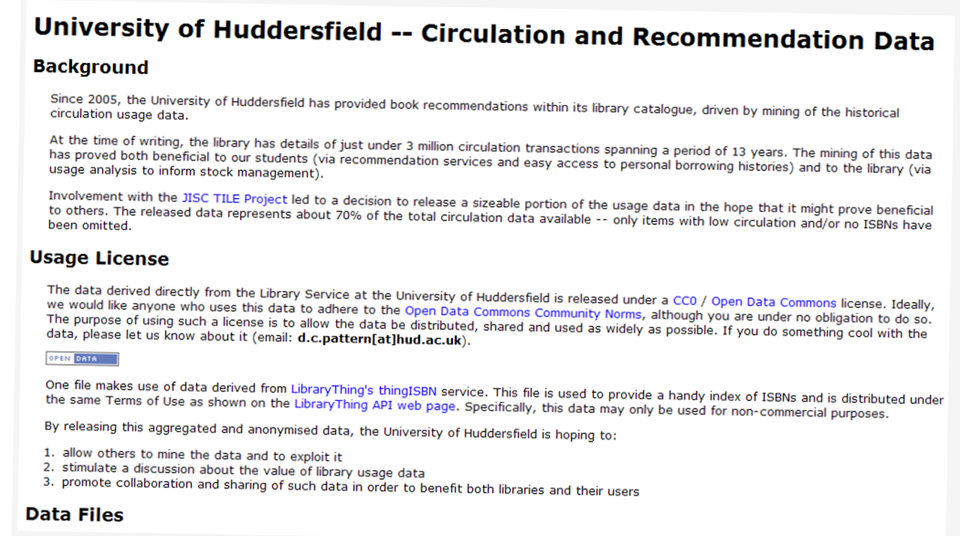

Sharing Data
usage data release (Dec 2008)
27
Notes:
aggregated usage data for 2 million circulation transactions, covering around 80,000 book titles & recommendation data for over 37,000 titles
http://library.hud.ac.uk/data/usagedata/
http://www.daveyp.com/blog/archives/528

Slide 28
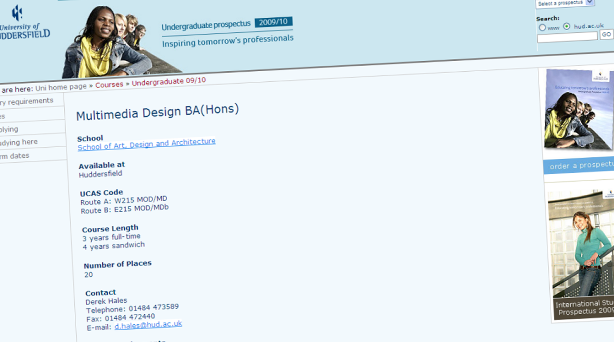
Sharing Data
BA Multimedia Design
28

Slide 29
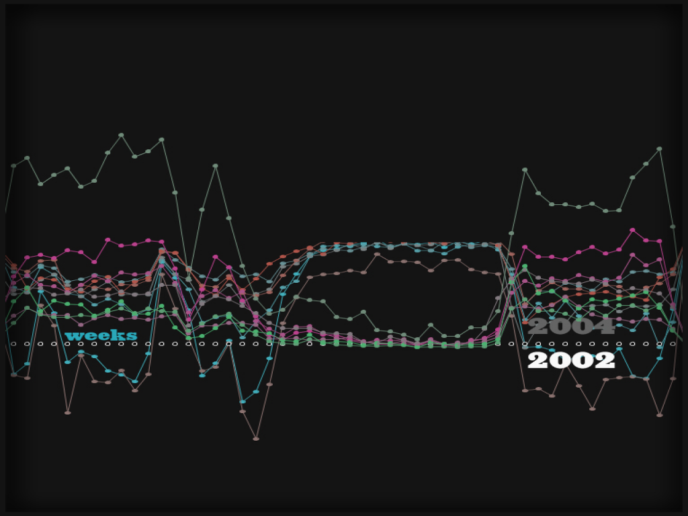

Slide 30
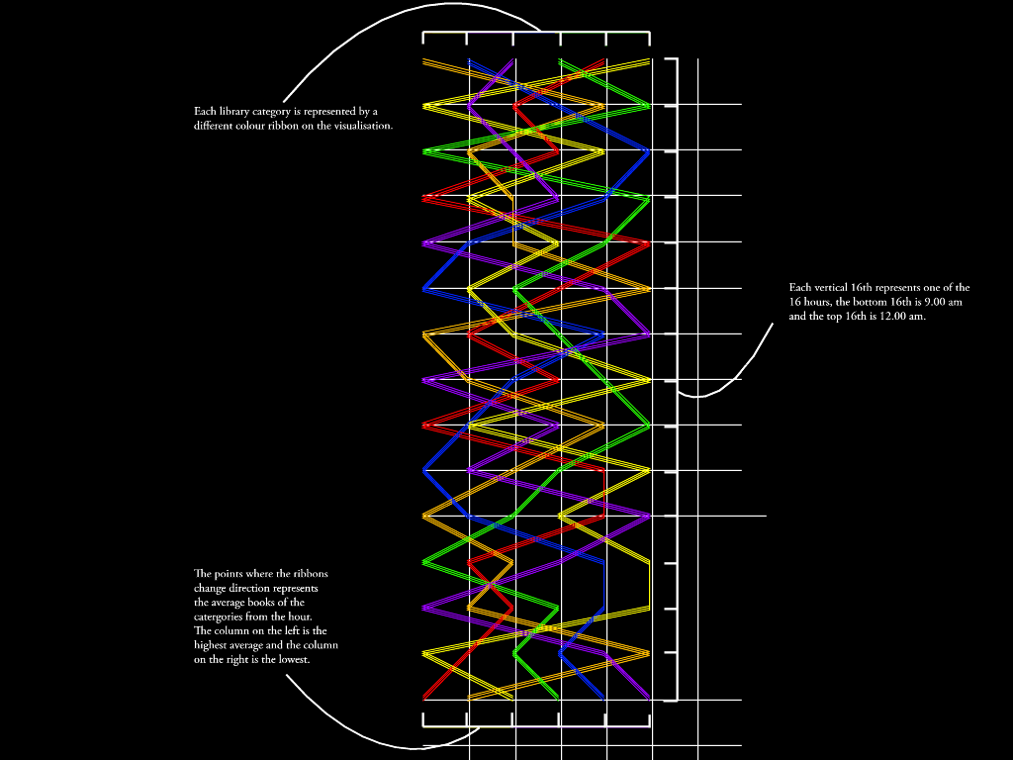

Slide 31
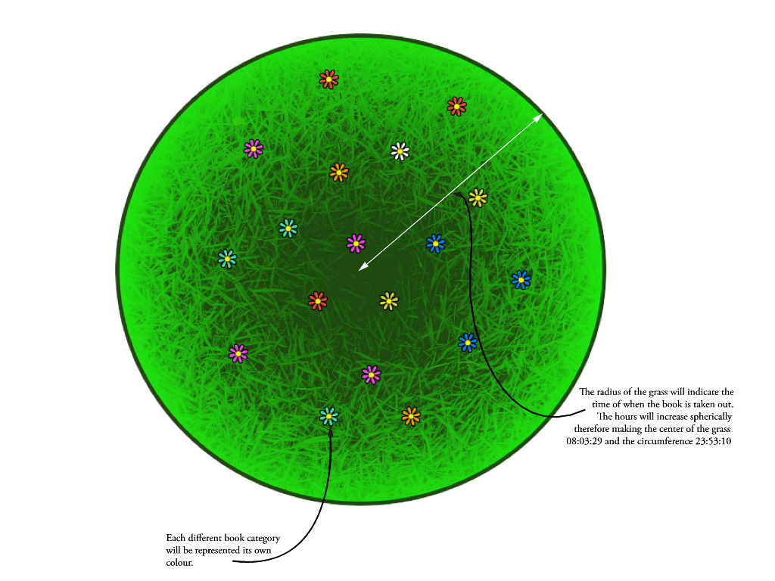

Slide 32

Non & Low Usage Project

Slide 33
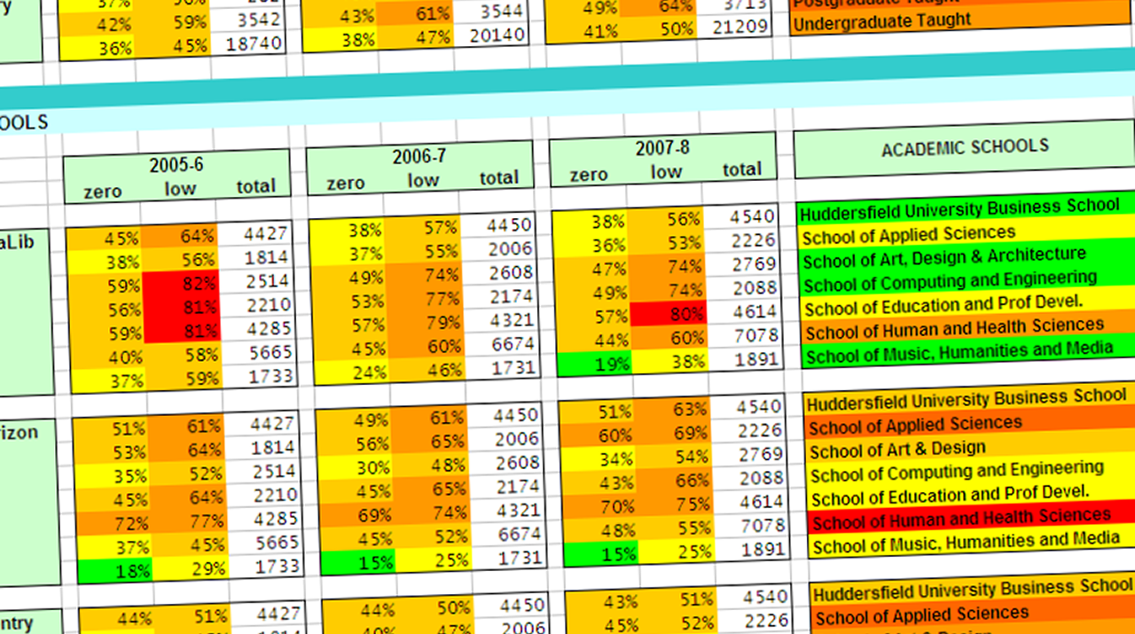
Non & Low Usage Project
digging deeper into data since 2005!
33

Slide 34
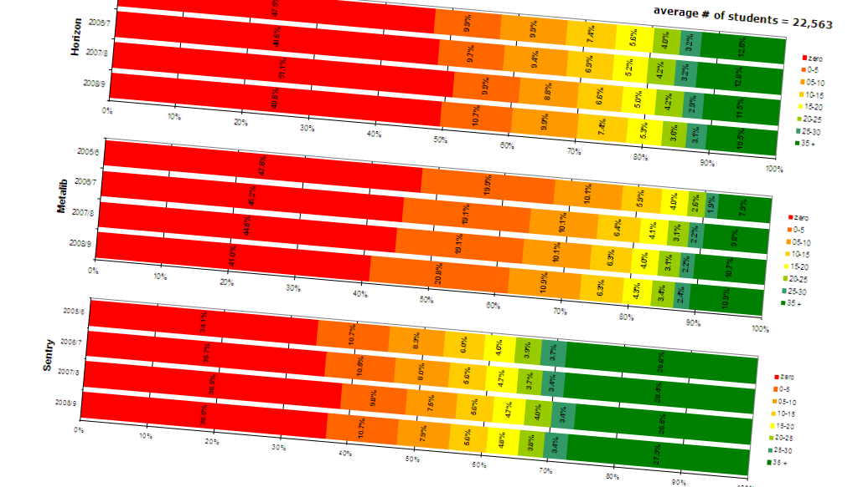
Non & Low Use Project
digging deeper into data
34

Slide 35
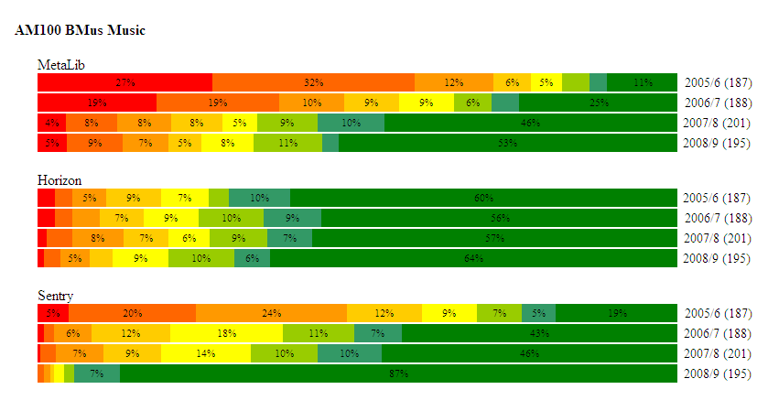
Non & Low Use Project
digging deeper into data

Slide 36
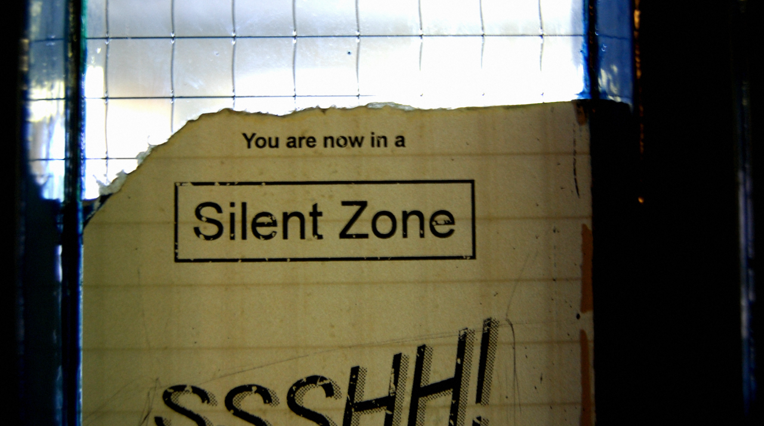
Measuring Library Impact
is there a link between usage & grade?

Slide 37
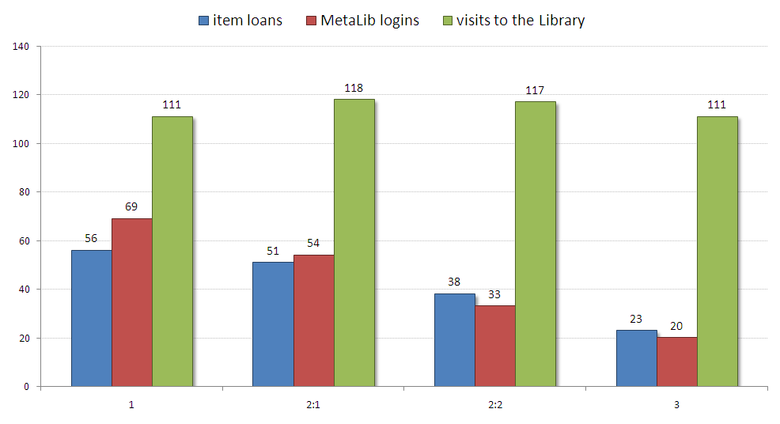
Measuring Library Impact
2008/9 & 2008/9 honours graduates
37

Slide 38
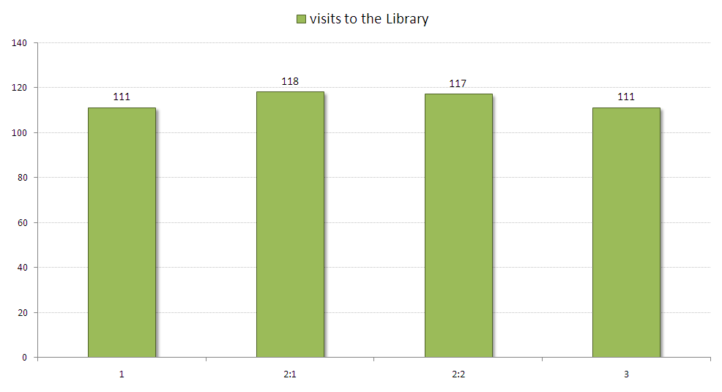
Measuring Library Impact
2008/9 & 2008/9 honours graduates
38

Slide 39
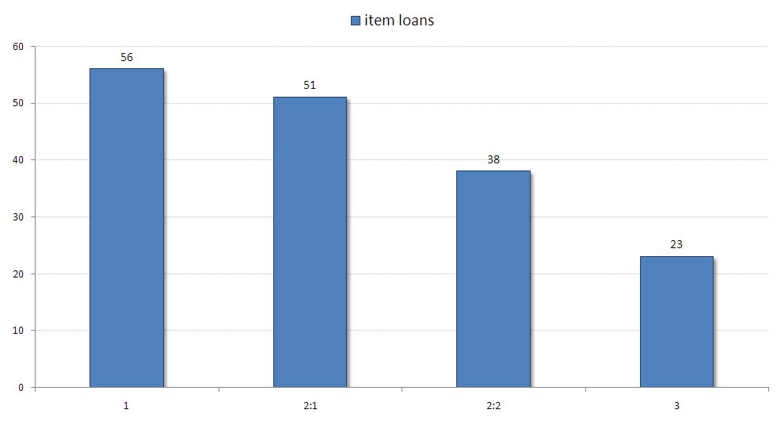
Measuring Library Impact
2008/9 & 2008/9 honours graduates
39

Slide 40
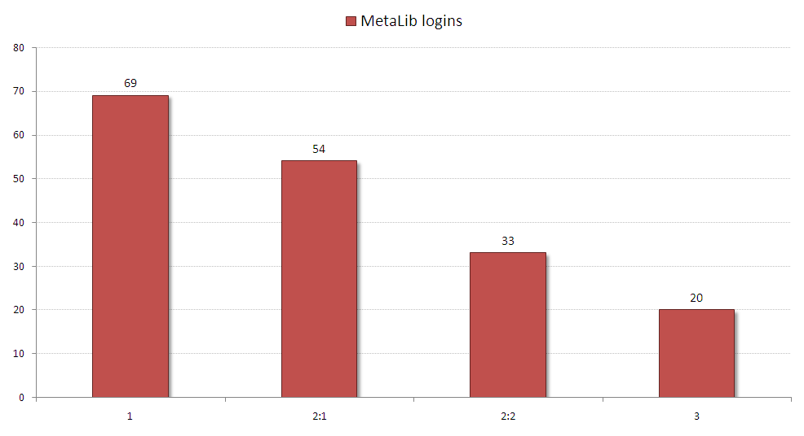
Measuring Library Impact
2008/9 & 2008/9 honours graduates
40

Slide 41
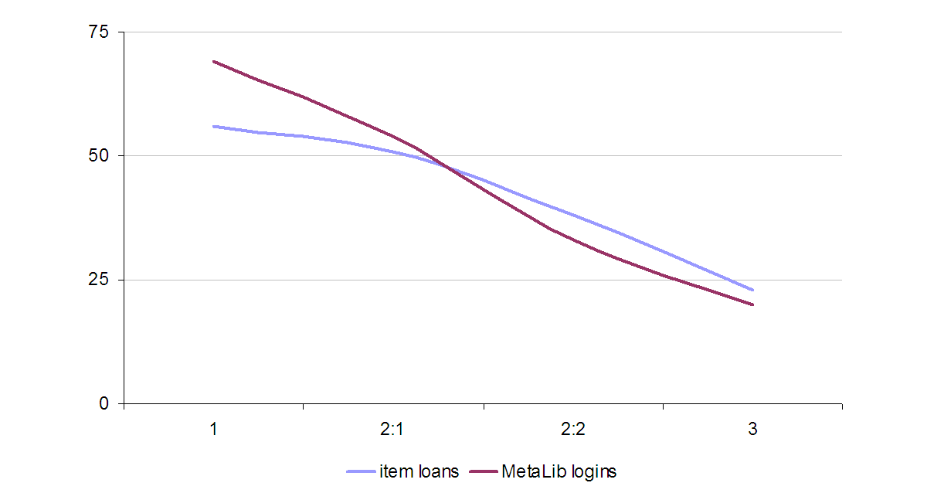
Measuring Library Impact
2008/9 & 2008/9 honours graduates
book loans
e-resource logins
41

Slide 42
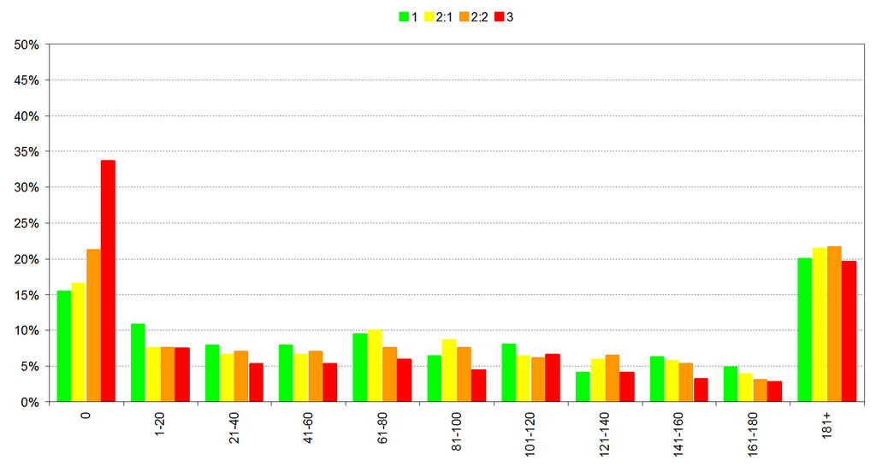
Measuring Library Impact
2008/9 & 2008/9 – library visits
15.5% of students who gained
a 1st never visited the library
34% of students who gained
a 3rd never visited the library
42

Slide 43
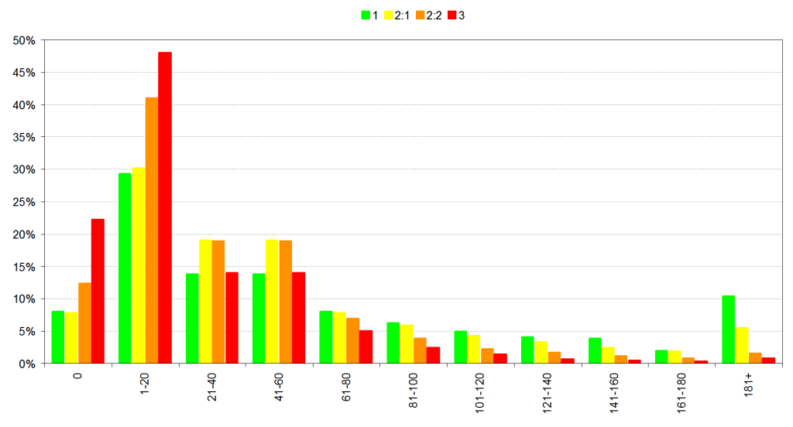
Measuring Library Impact
2008/9 & 2008/9 – MetaLib usage
70% of those who gained a
3rd logged in to e-resources
20 times or less over 3 years
10.5% of students who gained a
1st logged in more than 180 times
43

Slide 44
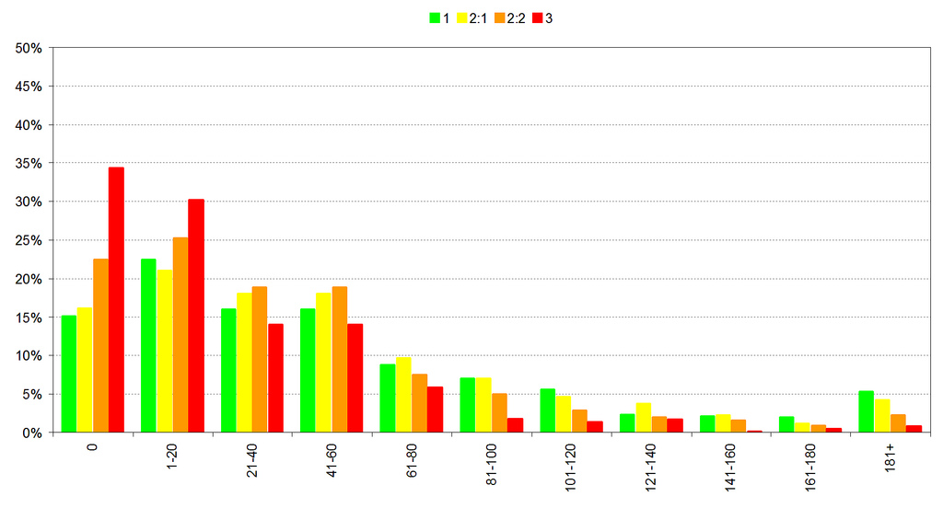
Measuring Library Impact
2008/9 & 2008/9 – book loans
15% of students who gained
a 1st never borrowed a book
34% of students who gained
a 3rd never borrowed a book
44

Slide 45
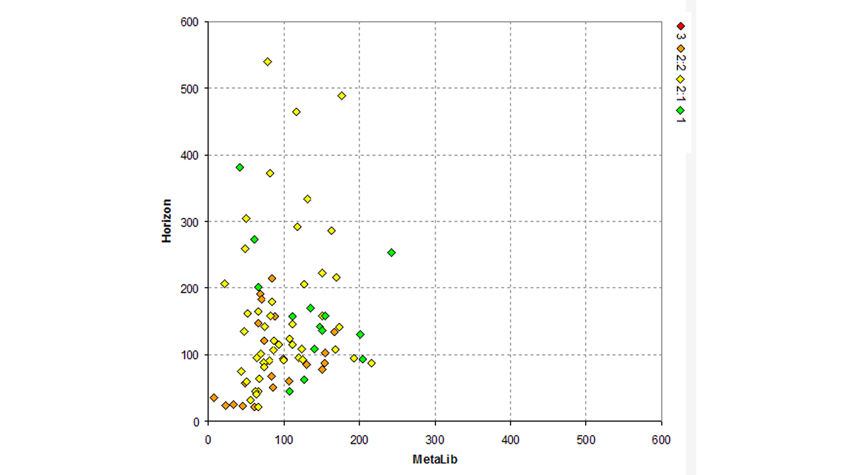
Measuring Library Impact
BSc Physiotherapy

Slide 46

JISC Library Impact Data Project
46

Slide 47
Library Impact Data Project
project hypothesis
“There is a statistically significant
correlation across a number of
universities between library activity
data and student attainment.”
  http://library.hud.ac.uk/lidp

Slide 48
Hashtags!
#lidp
#jiscad

Slide 49
Library Impact Data Project
JISC Activity Data Programme
University of Bradford
De Montfort University
University of Exeter
University of Huddersfield (lead partner)
University of Lincoln
Liverpool John Moores University
University of Salford
Teesside University
49

Slide 50
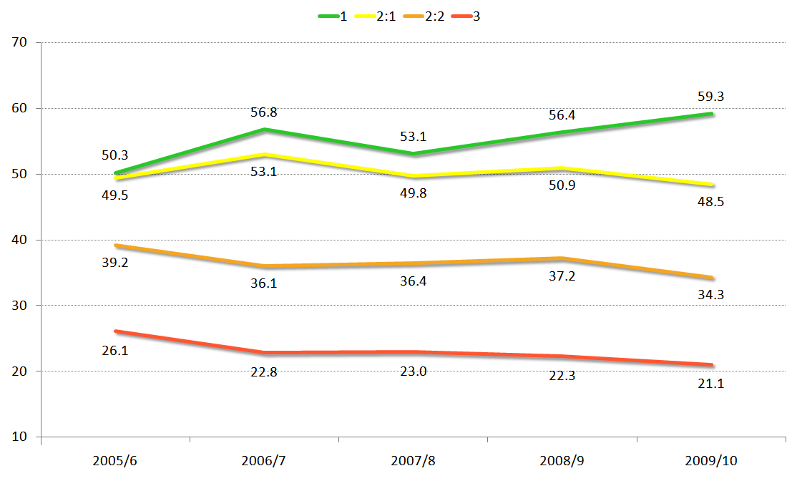
Library Impact Data Project
book loans at Huddersfield (5 years)
50
Notes:
Average number of books borrowed by students graduating with an honour for the last 5 years. For each student, 3 years worth of book loans are including in the average.
http://library.hud.ac.uk/blogs/projects/lidp/2011/04/12/5-years-of-book-loans-and-grades-at-huddersfield/

Slide 51
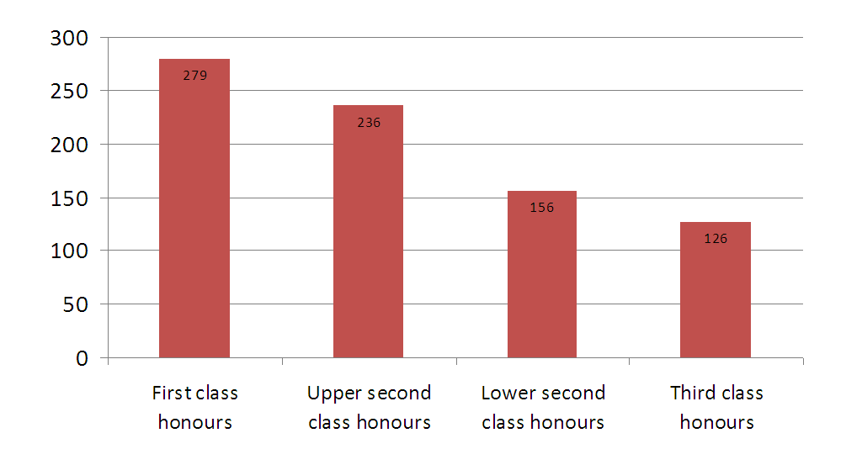
Library Impact Data Project
book loans inc. renewals (2009/10)

Slide 52
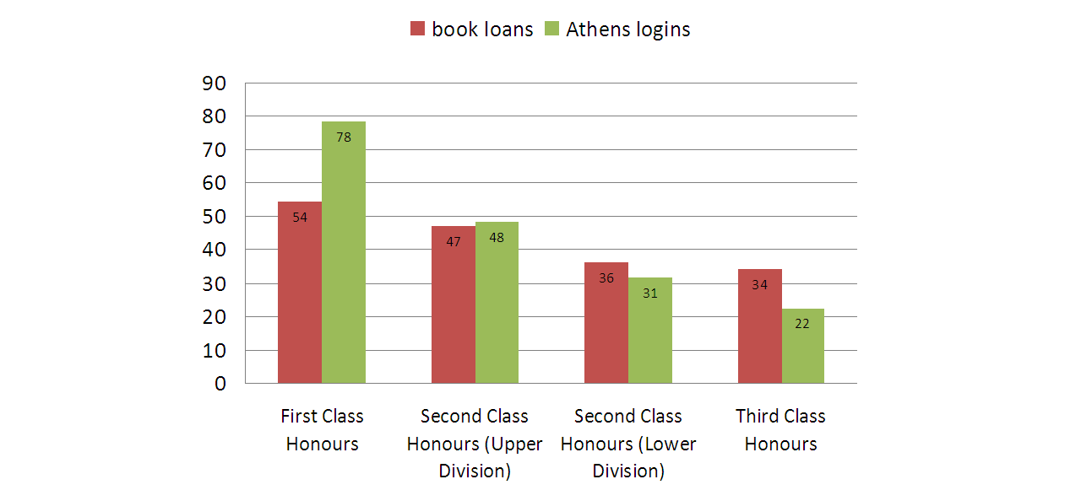
Library Impact Data Project
book loans & Athens (2009/10)

Slide 53
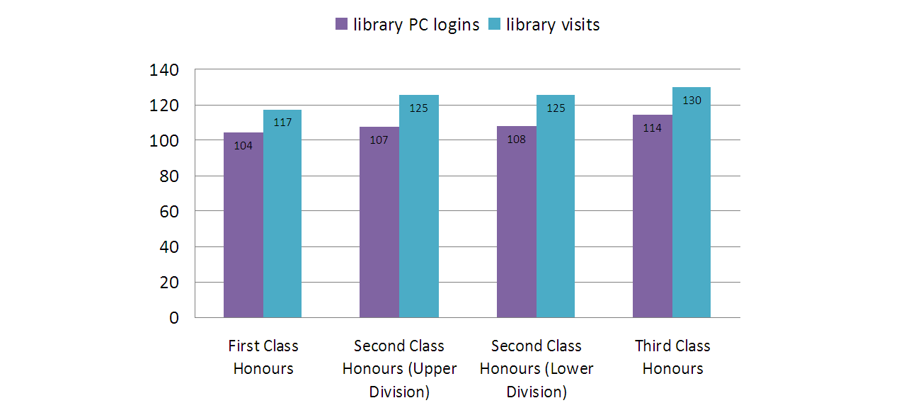
Library Impact Data Project
library PC logins & visits (2009/10)

Slide 54
Library Impact Data Project
project hypothesis
“There is a statistically significant correlation across a number of universities between library activity data and student attainment.”
  at this early stage, for books & e-resource usage, the correlation appears to be significant across all partner libraries

Slide 55
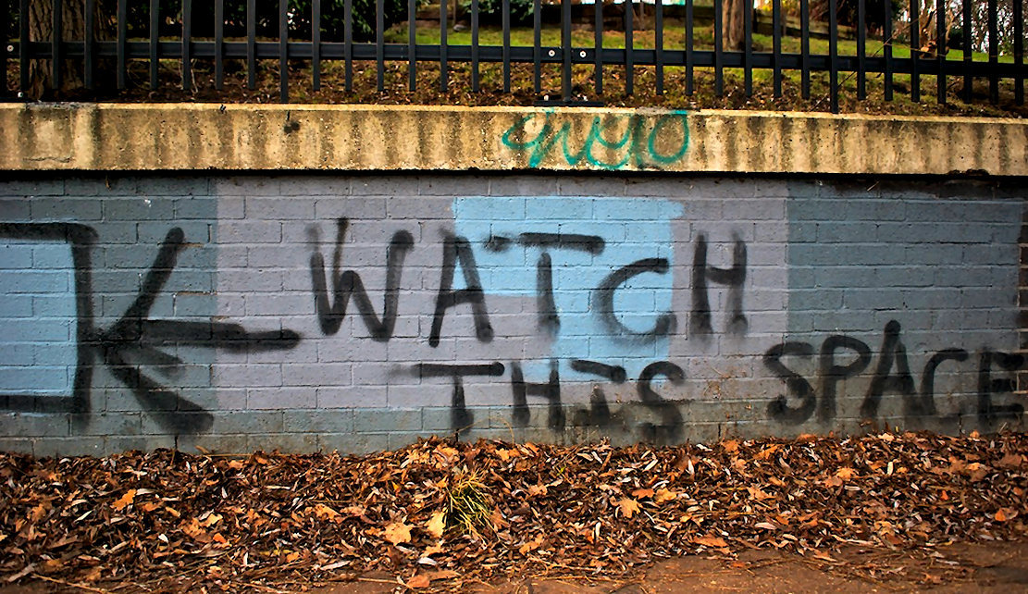
Library Impact Data Project
http://library.hud.ac.uk/lidp
http://www.flickr.com/photos/nicholasngkw/5512321874/
Notes:
Photo http://www.flickr.com/photos/nicholasngkw/5512321874/

Slide 56
So, what about that quote?!
“If you want to get laid,
go to college…

Slide 57
Thank you very much!
does anyone have any questions?
“If you want to get laid,
go to college…
…if you want an education,
go to the library.”
Frank Zappa (1940-1993)

